Slide 1
Capstone Project 2 WALMART SUPERSTORE SALES ANALYSIS MBM6
Presented By:
Laksmi Priya m

Slide 2
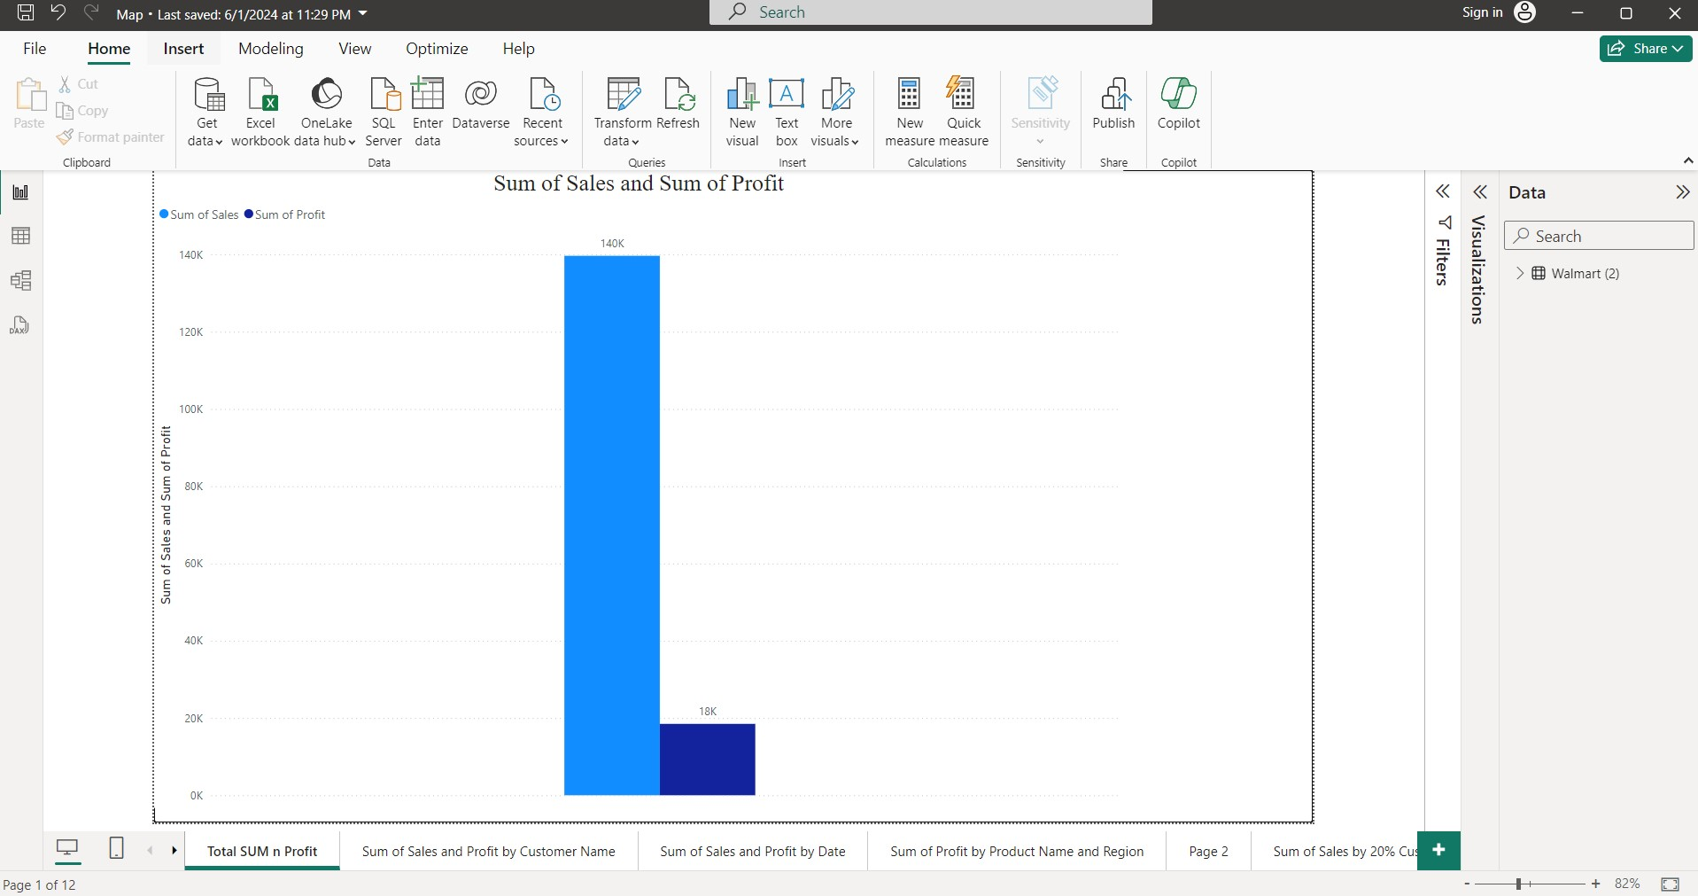
Sum of Sales and Profit

Slide 3
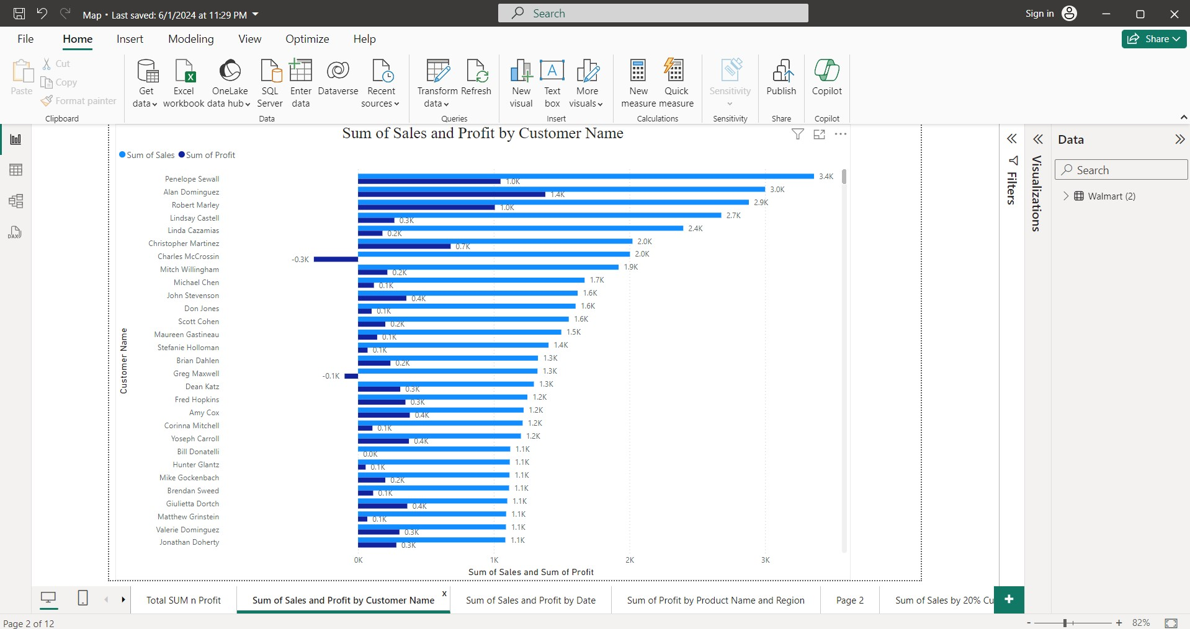
Sum Of Sales and profit for Each Customer

Slide 4
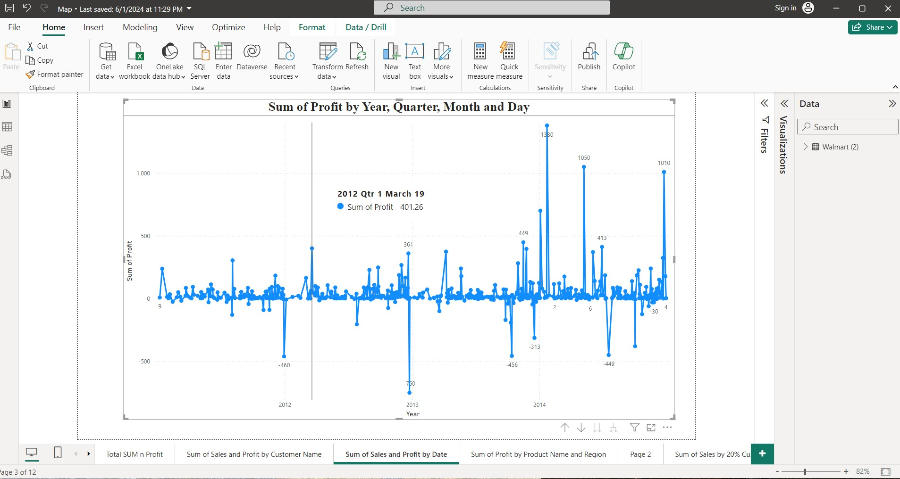
Sum Of Profit by Year, Quarter, Month and Day

Slide 5
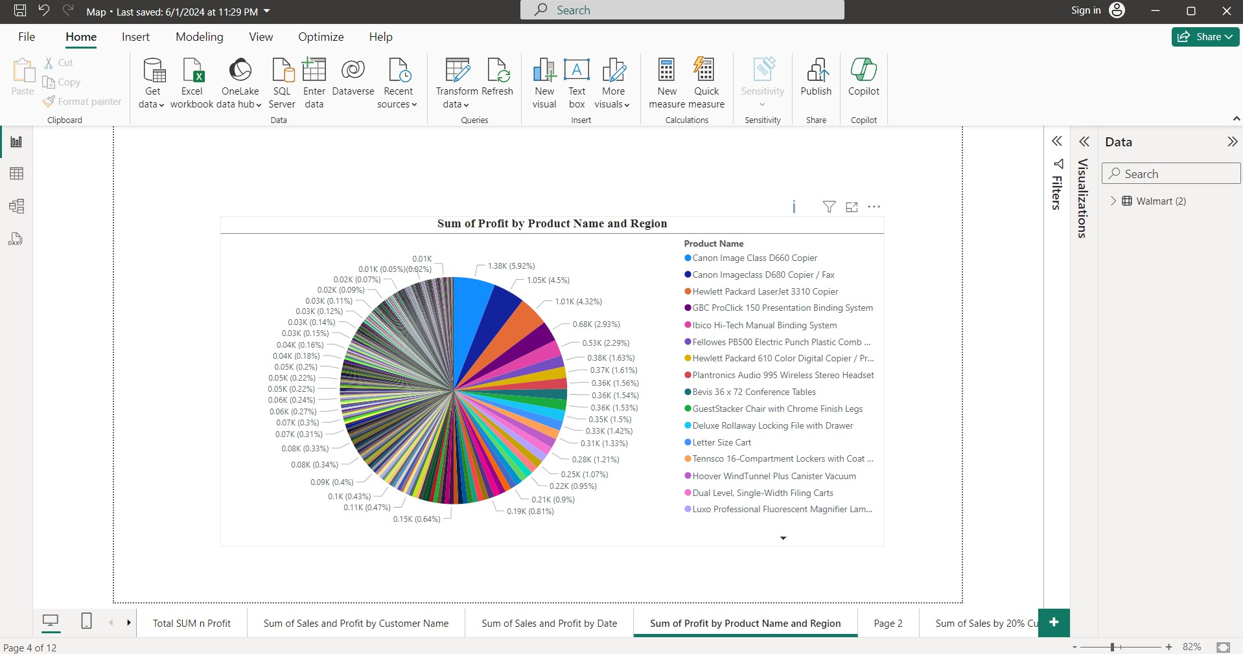
Sum of Profit by Product Name and Region

Slide 6
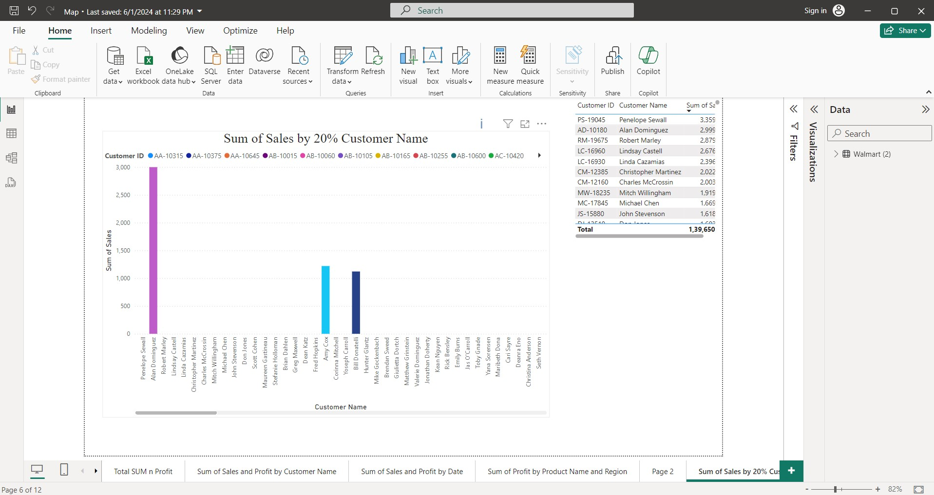
Sum Of Sales By 20% Of Customer

Slide 7
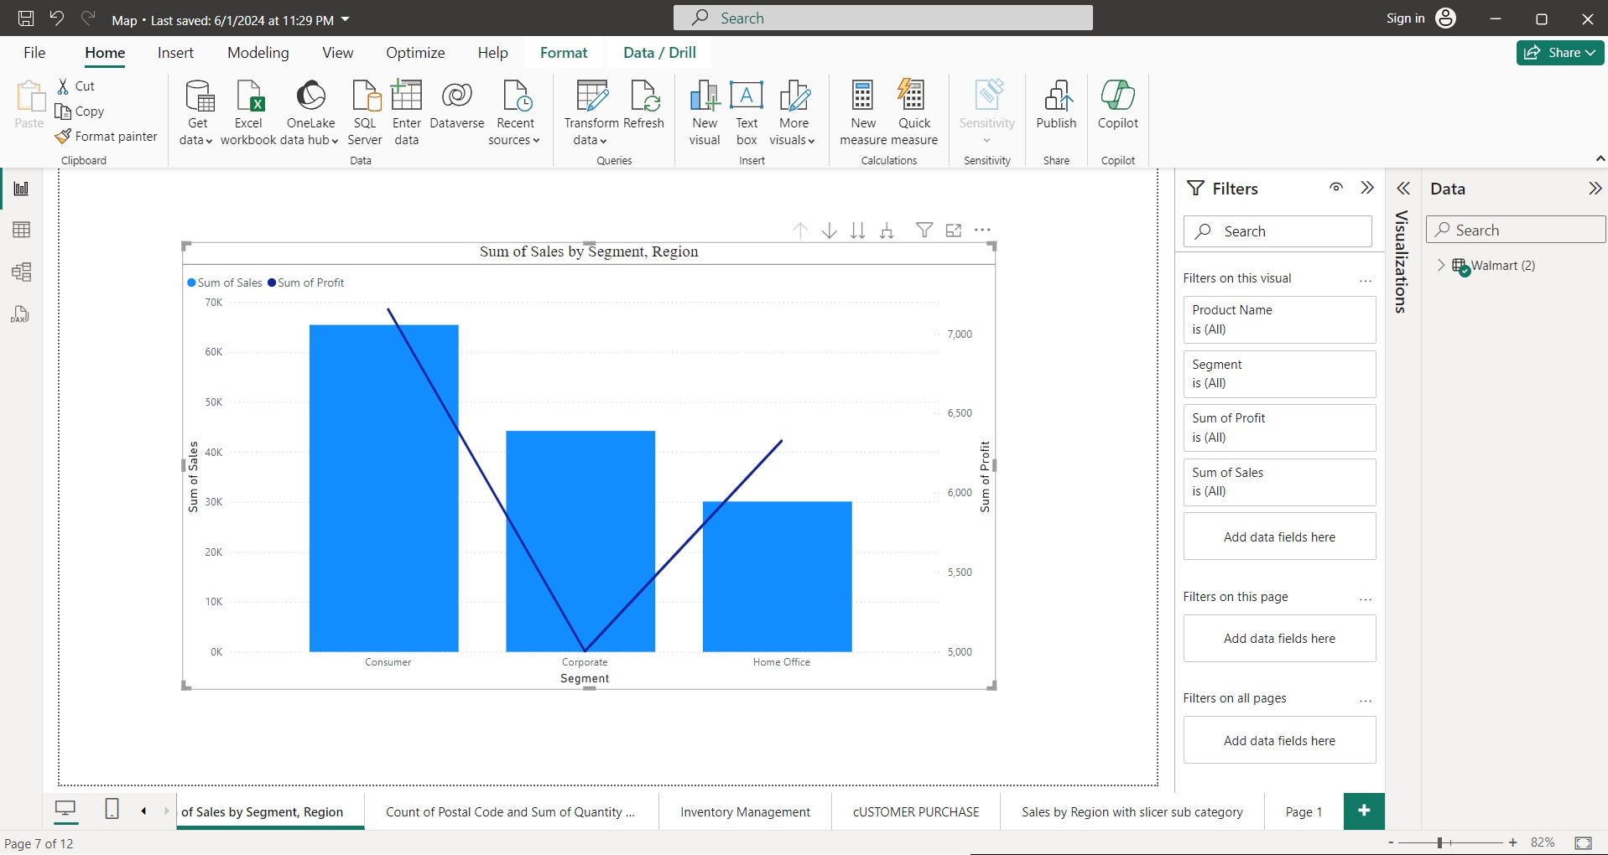
Sum Of Sales By Segment, Region and Profit

Slide 8
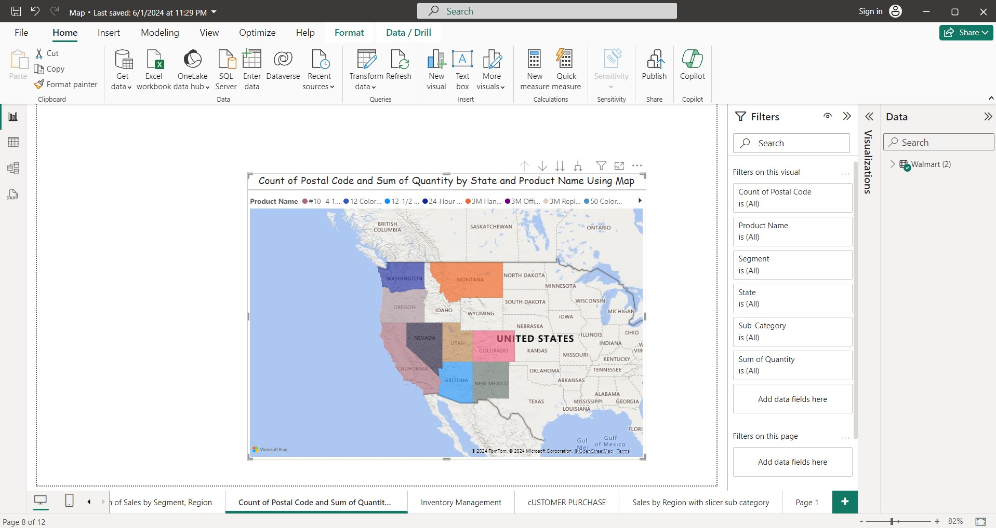
Product Quantity For Each State Using Map

Slide 9
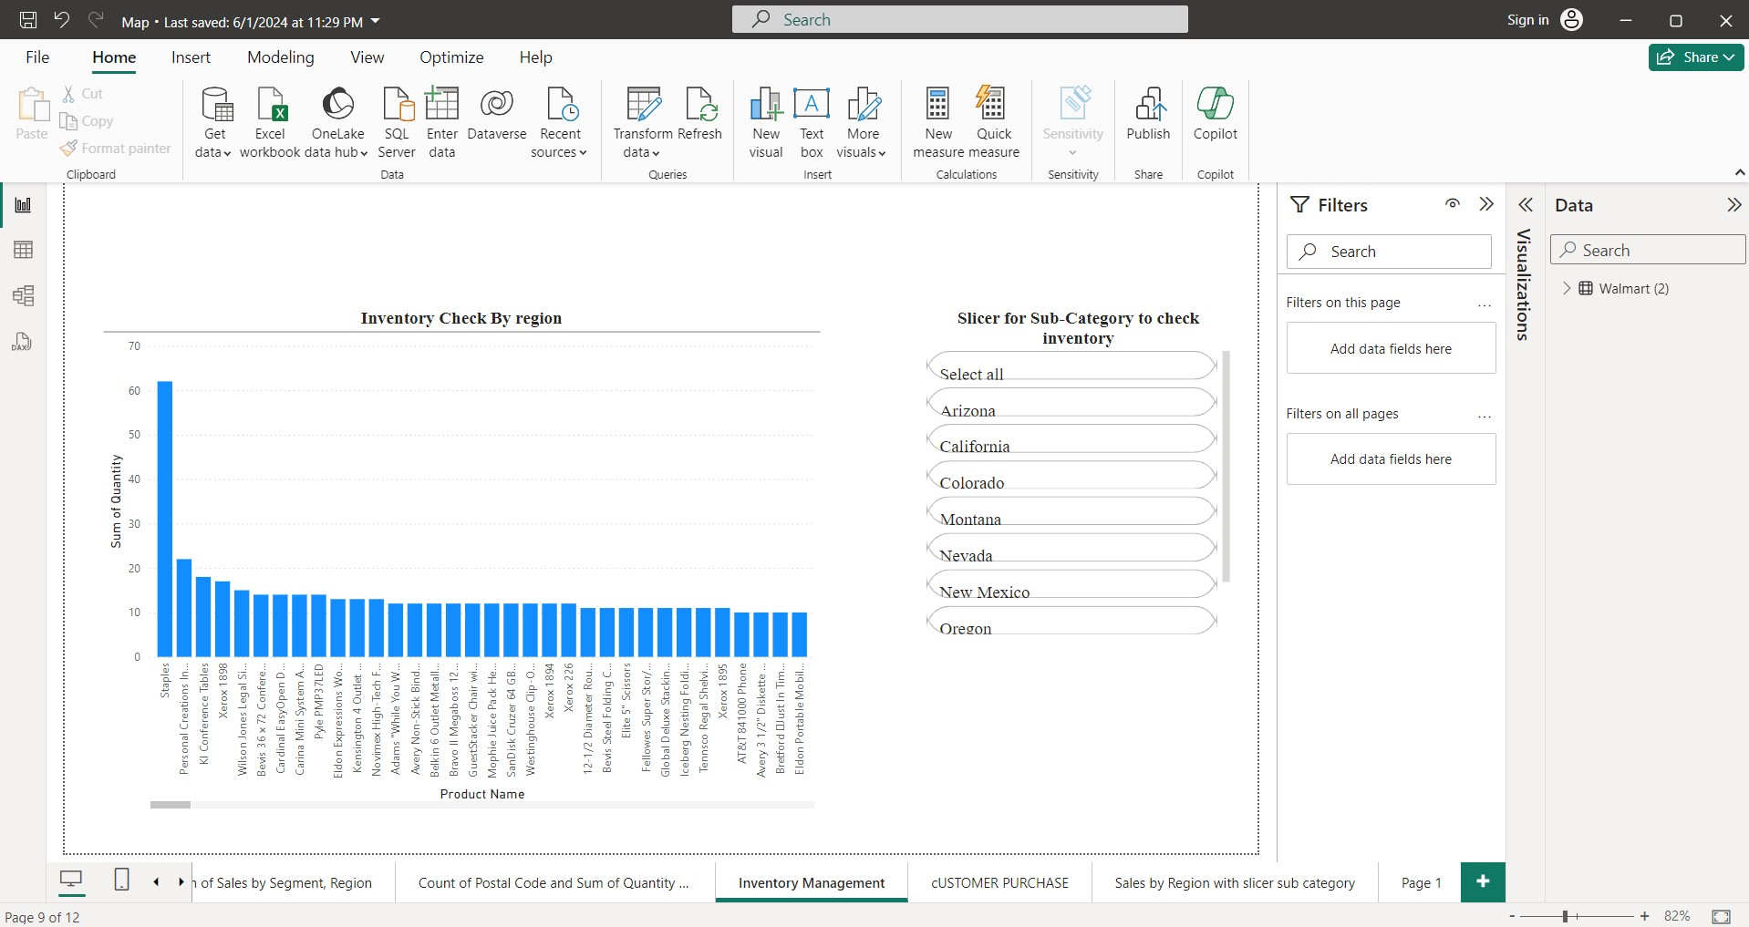
Inventory Management with Slicer

Slide 10
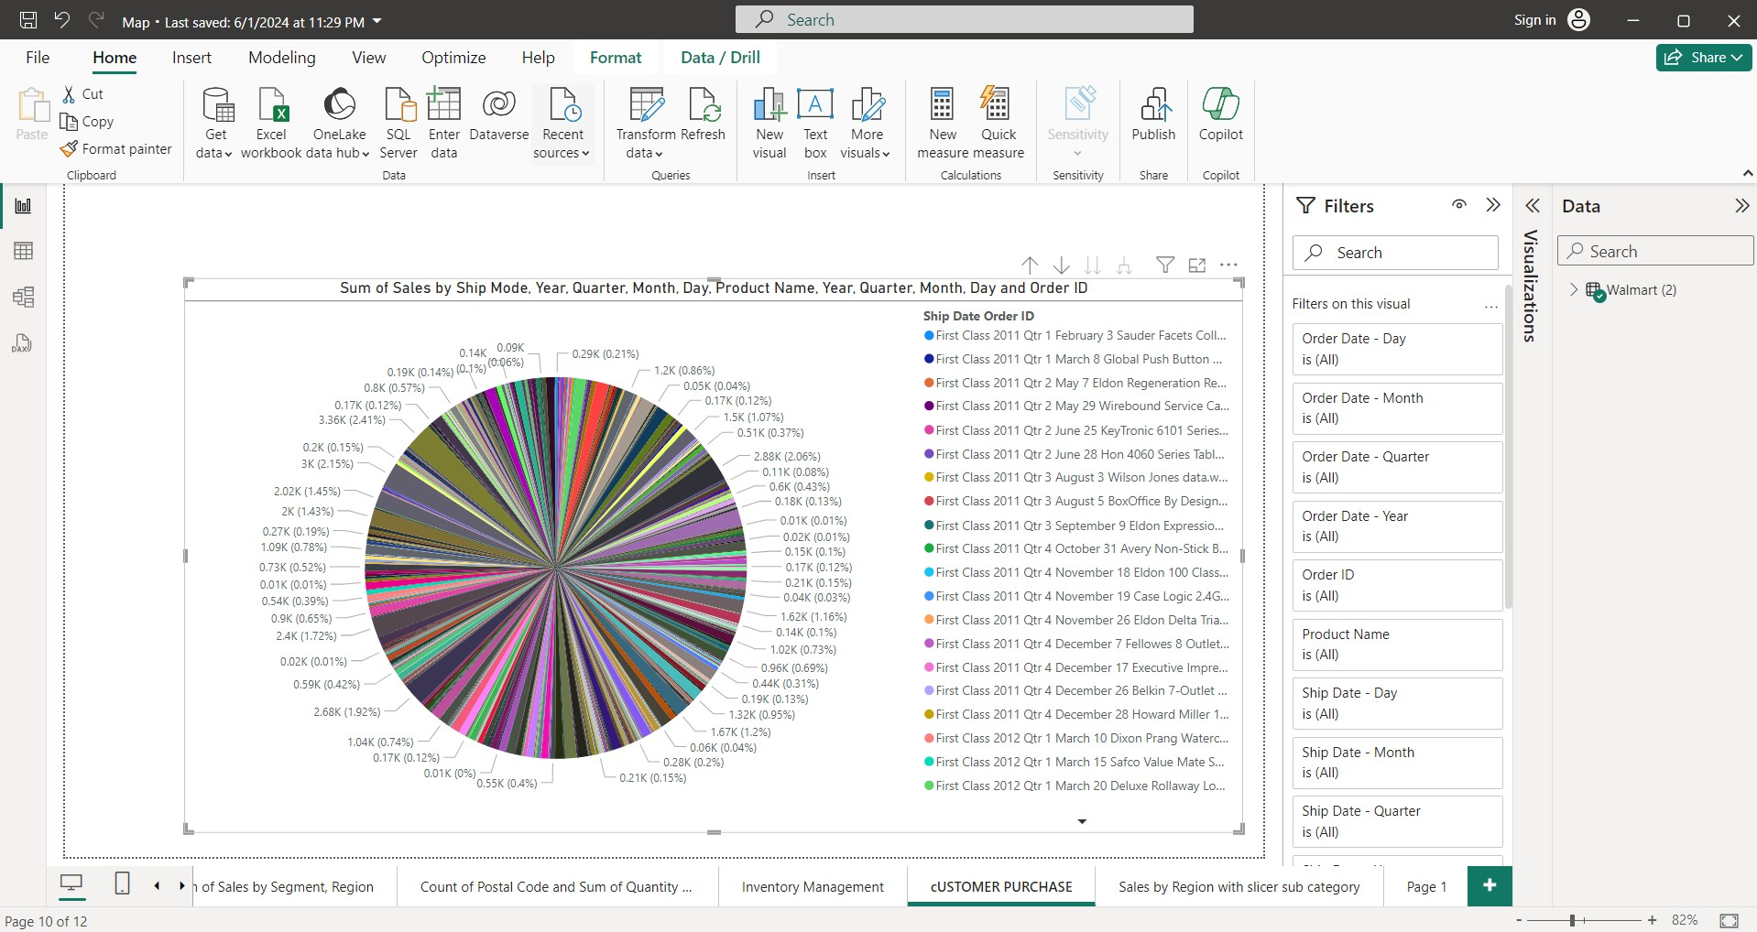
Customer Purchasing Details

Slide 11
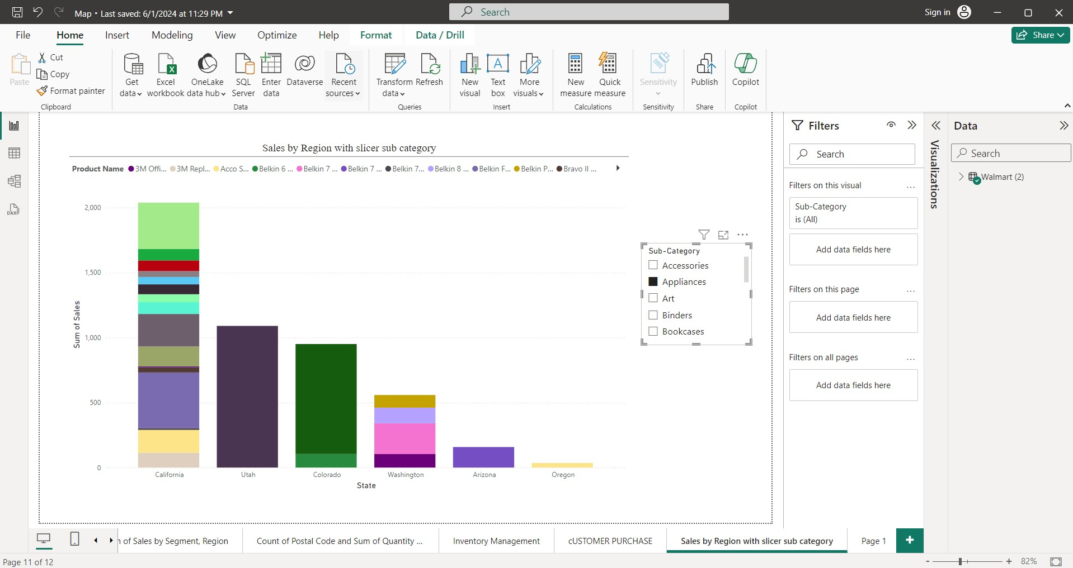
Sales By Region With Sub-Category

Slide 12
Root Cause Analysis
Regional Disparities:
Root Cause: Discrepancies in sales performance across different geographic regions indicate underlying factors influencing consumer behavior and purchasing patterns.
Inference: Economic factors, cultural preferences, and competitive landscape vary between regions, leading to differences in consumer spending habits and product demand.

Slide 13
Root Cause Analysis - Cntd
Product Category Performance:
Root Cause: Variations in sales performance among product categories suggest differing levels of market demand and customer preferences.
Inference: Factors such as seasonality, product innovation, and competitive pricing influence category performance, highlighting the importance of strategic product assortment and marketing strategies.

Slide 14
Root Cause Analysis - Cntd
Customer Segmentation:
Root Cause: Identification of distinct customer segments based on purchasing behavior and demographics implies diverse customer needs and preferences.
Inference: Tailoring marketing strategies and product offerings to specific customer segments can enhance customer satisfaction and loyalty, driving higher sales and revenue.

Slide 15
Root Cause Analysis - Cntd
Inventory Management Challenges:
Root Cause: Issues related to inventory turnover rates and stockout incidents indicate inefficiencies in inventory management practices.
Inference: Inaccurate demand forecasting, inadequate supply chain coordination, and suboptimal replenishment strategies contribute to inventory management challenges, necessitating improvements in forecasting accuracy and supply chain optimization.

Slide 16
Inferences:
Based on the root cause analysis, the following inferences can be drawn to inform strategic decision-making at Walmart:
Regional Strategy Development: Tailor marketing campaigns, product assortments, and pricing strategies to suit the unique characteristics and preferences of different geographic regions.
Category Optimization: Allocate resources towards high-performing product categories while exploring opportunities to revitalize underperforming categories through product innovation and targeted promotions.
Customer-Centric Approach: Adopt a customer-centric approach by leveraging customer segmentation insights to deliver personalized shopping experiences and enhance customer satisfaction.
Supply Chain Optimization: Invest in advanced analytics and supply chain technologies to improve demand forecasting accuracy, optimize inventory levels, and enhance overall supply chain efficiency

